Slide 1
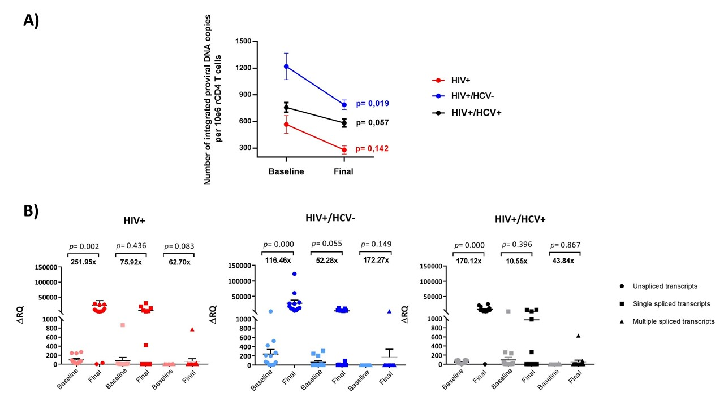
PEB0150 - Evolution of HIV reservoir and viral splicing after the elimination of HCV with DAAs in HIV/HCV patients
Paula Martínez-Román¹. Celia Crespo-Bermejo¹. Sonia Arca-Lafuente¹. Isabel Cortegano². Luz Martín-Carbonero³. Pablo Ryan⁴. Ignacio de los Santos⁵. Juan Miguel Castro-Álvarez³. Marta Gálvez-Charro³. Mariano Matarranz del Amo⁴. Jesús Sanz-Sanz⁵. Salvador Resino¹. Amanda Fernández-Rodríguez¹. Mayte Coiras⁶. Verónica Briz¹ on behalf of COVIHEP
1) Laboratory of Reference and Research on Viral Hepatitis. National Center for Microbiology. Institute of Health Carlos III. Majadahonda. Madrid. Spain. 2) Laboratory of Immunobiology. Institute of Health Carlos III. Majadahonda. Madrid. Spain. 3) Instituto de Investigación Sanitaria Hospital de la Paz (IdiPAZ). Madrid. Spain. 4) Department of Infectious Diseases. Infanta Leonor Hospital. Madrid. Spain. 5) Servicio de Medicina Interna-Infecciosas. Hospital Universitario de La Princesa. Madrid. Spain. 6) AIDS Immunopathology. Centro Nacional de Microbiología. Instituto de Salud Carlos III. Majadahonda. Madrid. Spain.
BACKGROUND
Previously our group observed an increase in HIV reservoir size in patients exposed to HCV (HIV+/HCV+ coinfected and HIV+/HCV- spontaneous clearers) compared to HIV+ monoinfected subjects in resting CD4 T cells (rCD4). We also observed an increase in multiple spliced RNA viral transcripts in HCV-exposed patients that could indicate that viral protein regulator Tat was being more actively synthesized leading to a higher yield of new HIV particles. However, the effect of HCV elimination with direct-acting antivirals (DAAs) on HIV reservoir and viral splicing remains unclear.
TABLE 1: Epidemiological characteristics of the study population
 | Total (n=50) | HIV+ (n=15) | HIV+/HCV- (n=16) | HIV+/HCV+ (n=19) | P
Men, n (%) | 27 (54.0) | 9 (60.0) | 9 (56.3) | 9 (47.4) | 0.773
 | 50.5 (42.8-53.3) | 45.0 (36.0-53.0) | 52.5 (48.8-53.0) | 49.0 (43.0-55.0) | 0.132
Weight (kg) | 66.9 (60.8-78.5) | 67.7 (61.8-84.8) | 71.0 (64.0-82.0) | 60.2 (55.0-70.0) | 0.017
Height (cm) | 165 (160-171) | 168 (162-174) | 166 (162-172) | 163 (160-167) | 0.145
BMI (kg/m²) | 24.2 (22.0-25.9) | 24.2 (20.4-29.0) | 66.0 (63.3-74.6) | 24.5 (20.3-26.0) | 0.105
Infection time (years) |  | 9.0 (6.0-22.0) | 17.5 (11.3-26.8) | 17 (12.0-26.0) | 0.020
Transmission Route, n (%)
IDUs | 20 (40.0) | -- | 11 (68.8) | 9 (47.4) | 0.001
MSM | 11 (22.0) | 7 (46.7) | 2 (12.5) | 2 (10.5)
WSM | 8 (16.0) | 5 (33.3) | 1 (6.3) | 2 (10.5)
Others | 5 (10.0) | 1 (6.7) | 1 (6.3) | 3 (15.8)
Unknown | 6 (12.0) | 2 (13.3) | 1 (6.3) | 3 (15.8)
Clinical stage, n (%)
AIDS | 29 (63.0) | 7 (46.7) | 10 (62.5) | 12 (63.2) | 0.279
NON-AIDS | 21 (42.0) | 8 (53.3) | 6 (37.5) | 7 (36.8)
cART regimen, n (%)
NRTIs | 1 (2.0)) | 1 (6.7) | -- | -- | 0.657
NNRTIs | 16 (32.0) | 4 (26.7) | 4 (43.8) | 5 (26.3)
PI | 5(10.0) | 2 (13.3) | 2 (12.5) | 1 (5.3)
II | 23 (46.0) | 6 (40.0) | 6 (37.5) | 11 (59.9)
Bitherapy | 4 (8.0) | 2 (13.3) | 1 (6.3) | 1 (5.3)
Monotherapy | 1 (2.0) | -- | -- | 1 (5.3)
IFNL3 (IL28B) genotype, n (%)
CC | 26 (52.0) | 6 (40.0) | 14 (87.5) | 6 (31.6) | 0.003
Non-CC | 20 (40.0) | 5 (33.3) | 2 (12.5) | 12 (68.4)
Unknown | 4 (8.0) | 4 (26.7) | -- | --
TABLE 2: Viral reservoir size in resting CD4+ T cells of the different study groups
 | UNIVARIATE ANALYSIS
GROUPS | Integrated HIV DNA Baseline | Integrated HIV DNA Final | P
HIV+ | 574.1±176.1 | 291.9±81.2 | 0.041
HIV+/HCV- | 1354.8±424.7 | 871.1±239.2 | 0.070
HIV+/HCV+ | 864.2±265.7 | 584.3±200.6 | 0.145
METHODS
Longitudinal study (52 weeks follow-up) in 50 aviremic patients: 19 HIV+/HCV+, 16 HIV+/HCV- and 15 HIV+ subjects. Using different Alu-LTR PCRs viral spliced RNA transcripts and the number of proviral DNA copies integrated in resting CD4+ (rCD4) T cells were quantified. Paired samples were analyzed using a generalized mixed linear model.
 | MULTIVARIATE ANALYSIS
GROUPS | Integrated HIV DNA Baseline | Integrated HIV DNA Final | P
HIV+ | 561.1±192.7 | 279.1±83.9 | 0.142
HIV+/HCV- | 1249.1±360.1 | 806.5±209.0 | 0.019
HIV+/HCV+ | 938.7±273.8 | 605.9±205.2 | 0.057
RESULTS
All HIV+/HCV+ patients achieved sustained virological response after taking DAAs. A significant decrease in HIV proviral DNA was observed at the end of follow-up in HCV exposed patients: HIV+/HCV- (Baseline: 1354.8 vs Final: 871.1 HIV DNA copies/10e6 cells;p=0.019)) and a tendency in HIV+/HCV+ individuals (693.8 vs 551.8;p=0.057); (Fig 1A). All forms of viral splicing had an increased ΔRQ at the end of follow-up (Fig 1B). However, only unspliced RNA transcripts showed a significant increase: HIV+ (251.95x ΔΔRQ; p=0.002); HIV+/HCV- (116.46x; p<0.001); HIV+/HCV+ (170.12x; p<0.001).
FIGURE 1: Evolution of HIV reservoir size and viral splicing in resting CD4+ T cells of the different study groups
CONCLUSIONS
Evolution of HIV reservoir size in previously HCV-exposed patients showed a decrease in the number of proviral DNA copies in rCD4 cells. However HIV reservoir size remains higher than in HIV+ group.
A significant increase in unspliced viral transcripts does not condition the replenishment of the viral reservoir.
Our results show that clearance of HCV from HIV-infected patients reinstate the dynamics of HIV reservoir. Early treatment of HCV in coinfected patients that do not spontaneously clear the infection could suppose a better prognosis of HIV infection in these patients.
Corresponding author: Verónica Briz, veronica.briz@isciii.es
PRESENTED AT THE 23RD INTERNATIONAL AIDS CONFERENCE (AIDS 2020) | 6-10 JULY 2020

