Slide 1
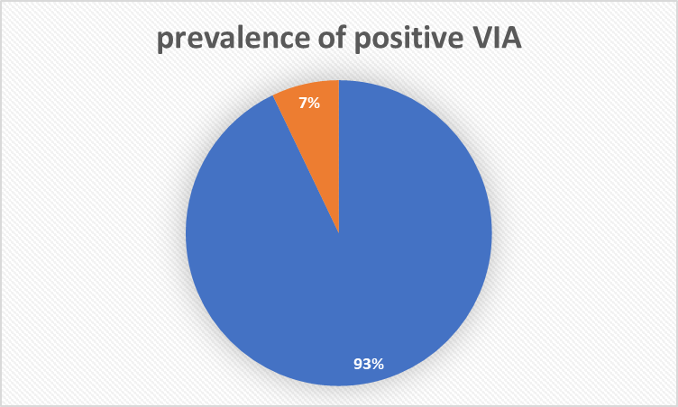
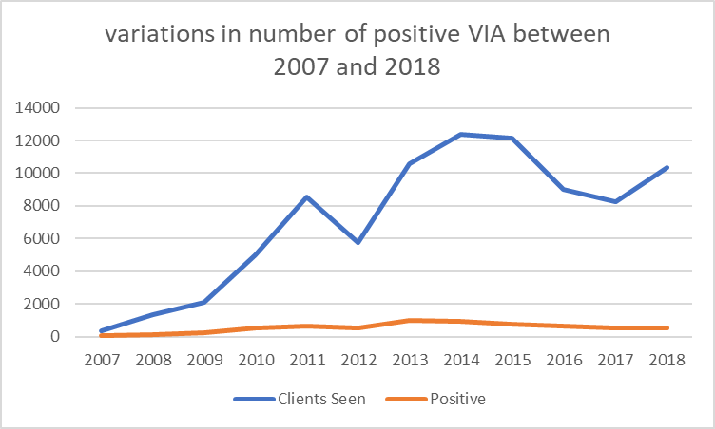
Cervical Cancer Screening in HIV positive women: experience from the Cameroon Baptist Convention Women’s Health Program
D.M. Bonghaseh¹, M. Simon², K. Nulah³, F. Manjuh⁴
¹Etoug-Ebe Baptist Hospital, Women's Health Department, Yaounde, Cameroon, ²CBC Health Services, Reproductive Health, Bamenda, Cameroon, ³CBC Health Services, Database Manager, Bamenda, Cameroon, ⁴CBC Health Services, Women's Health Supervisor, Yaounde, Cameroon
Background
Cervical cancer is the 4th most common malignancy in women worldwide
It is the 2nd most commonly diagnosed cancer among women in low and middle-income countries
It is one of the leading causes of cancer related morbidity and mortality in Cameroonian women
Its incidence has seen a great increase since the start of the HIV epidemic
It is also a major cause of morbidity and mortality in women living with HIV/AIDS
Prevention and early detection through massive low-cost screening campaigns is key to improving quality of life and increasing survival
Description
The Women’s Health Program (WHP) of the Cameroon Baptist Convention Health Services was set-up in 2007
It is a nurse-led comprehensive women-centered sexual and reproductive health program
Its cervical cancer prevention (screening and vaccination) is the largest of its kind in Cameroon
The program started with the “see and treat” method of screening
Visual Inspection with Acetic acid (VIA) /Visual Inspection with Lugol's Iodine (VILI) was the main screening method
The average cost of screening was set at USD 5.92
Positive (precancerous) lesions are treated with cryotherapy or Loop Electrosurgical Excision procedure (LEEP)
Biopsy is done for suspected cases of malignancy
New technologies such as a portable colposcope with a better magnification linked to a mobile application integrated into a Samsung device is currently being used as the main screening method
Lessons Learned
Between 2007 and 2018, 85847 women were screened for cervical cancer in the WHP
7% was positive for VIA
There was little variations in the number of positive VIA cases between 2007 and 2018
HIV was positive in 9443 (9.1%) women
VIA was positive in 1139 (12.1%) HIV positive women
VIA was positive in 5429(6.85%) HIV negative women
These results highlight the success of a low-cost nurse-led program for the prevention, detection, and management of cervical cancer in both HIV positive and HIV negative women
Conclusion
These results highlight the success of a low-cost nurse-led program for the prevention, detection, and management of cervical cancer in both HIV positive and HIV negative women
We also recommend further longitudinal studies to be carried to evaluate the effectiveness of the "see and treat" method in preventing future development of cervical cancer in Cameroon
References
https://www.who.int/westernpacific/health-topics/cervical-cancer.
http://gco.iarc.fr/today/home.
https://cbchealthservices.org/services/women-health-program/.
PRESENTED AT THE 23RD INTERNATIONAL AIDS CONFERENCE (AIDS 2020) | 6-10 JULY 2020

