Slide 1
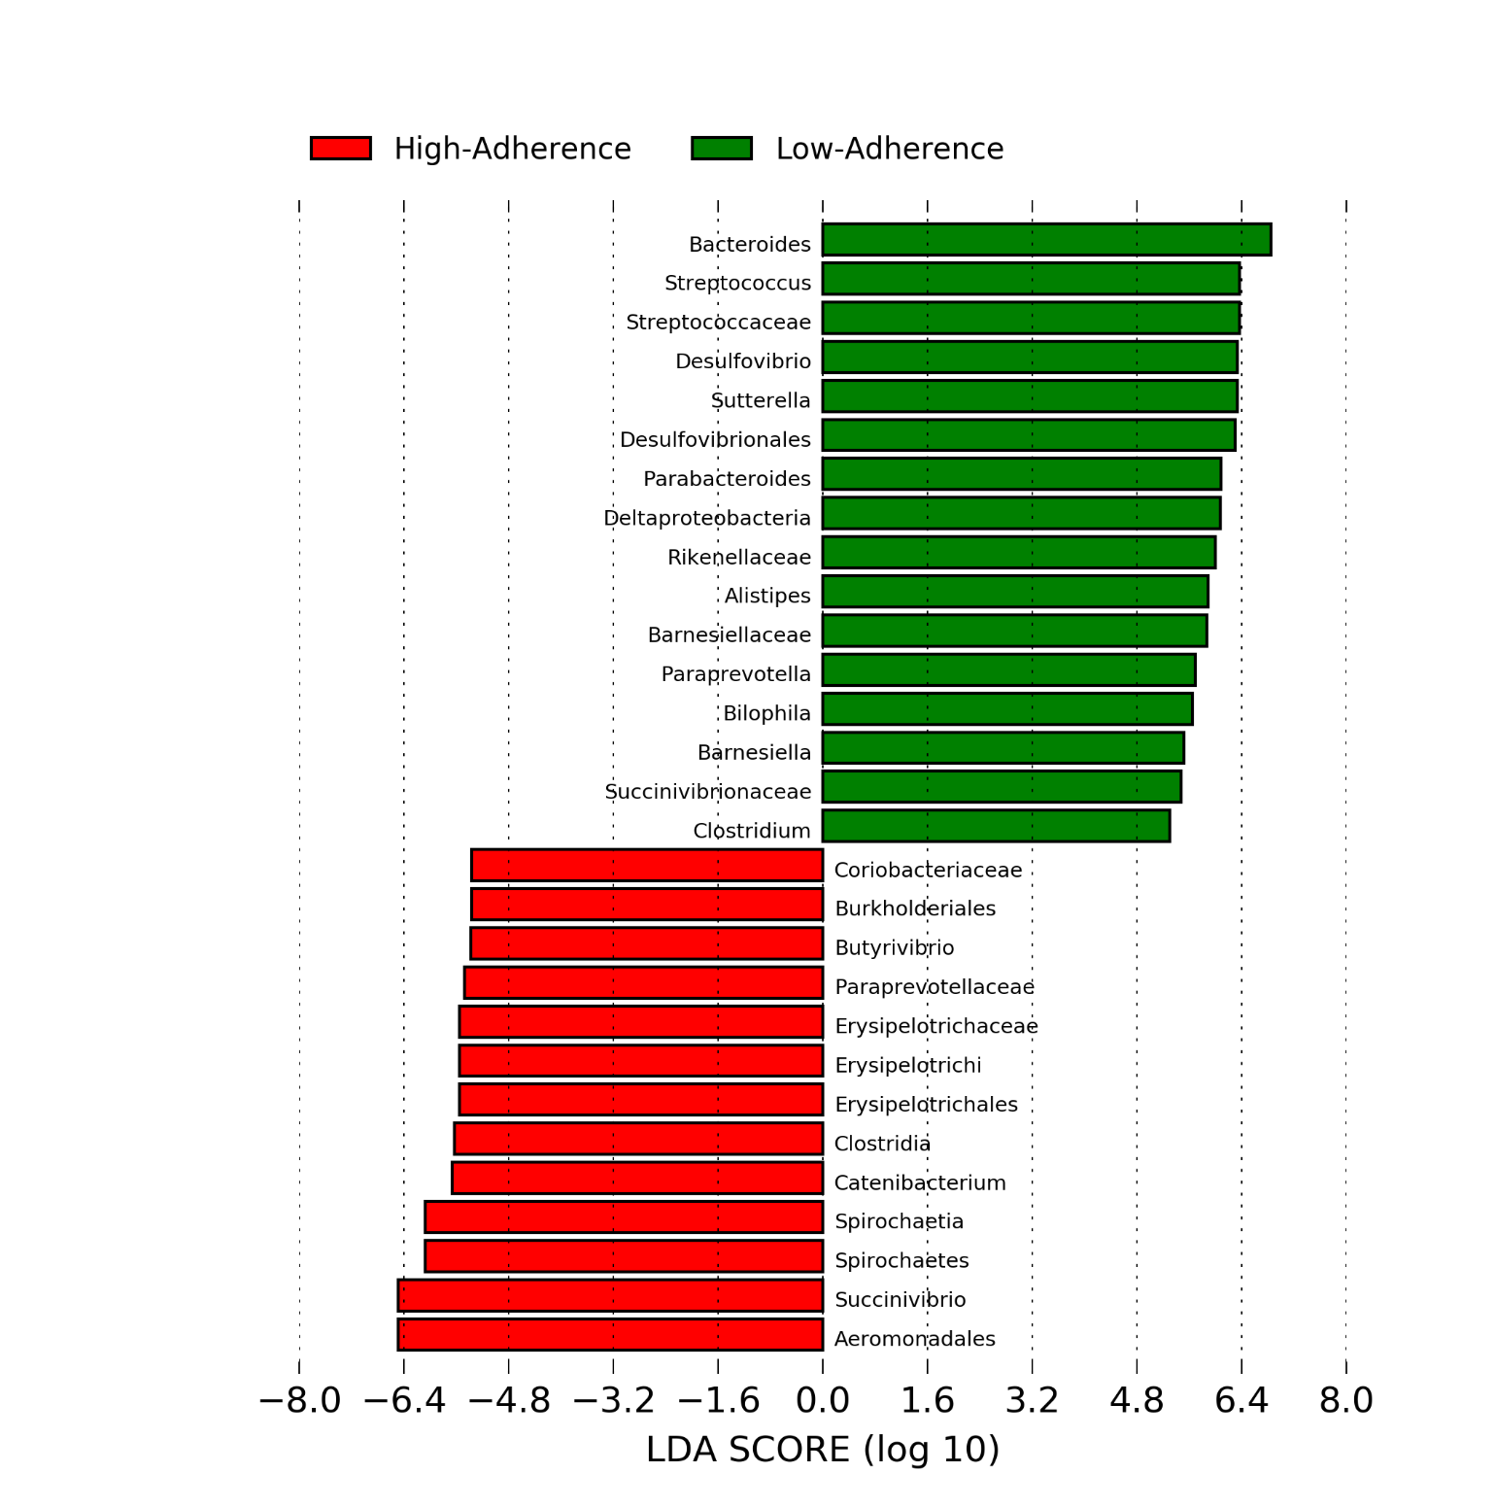
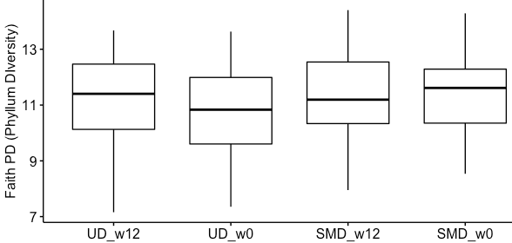
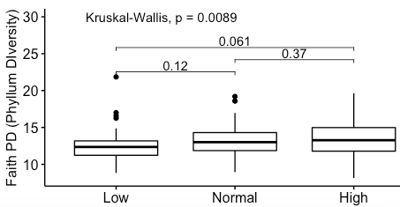
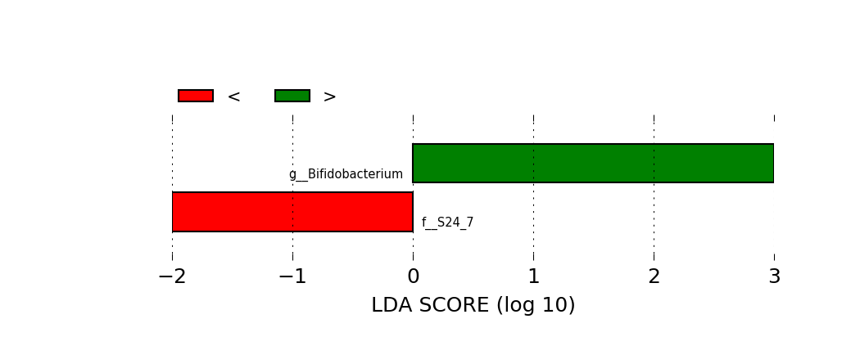





PEB0273
Influence of a Supplemented Mediterranean Diet on the Gut Microbiome Profile in HIV-1 infected individuals
Roque Pastor-Ibáñez ¹, Juan Blanco-Heredia ², Florencia Etcheverry ¹, Francisco Díez ¹, Constanza Lucero ¹, Lorna Leal ¹, Sonsoles Sánchez-Palomino ¹, Rosa Casas ³, María Ángeles Navarrete-Muñoz ³, Norma Rallón ⁴, José Miguel Benito ⁴, Marc Noguera-Julian ⁵, Roger Paredes ⁵, Ramón Estruch ³, David Torrents ⁶, Felipe García ¹
¹ Hospital Clínic-HIVACAT, University of Barcelona, Barcelona, Spain., Barcelona, ² Computational Genomics Groups. Barcelona Supercomputing Center (BSC) & IrsiCaixa, Badalona, Spain, Barcelona, ³ Department of Internal Medicine, Hospital Clinic, Institut d’Investigació Biomèdica August Pi I Sunyer (IDIBAPS), University of Barcelona, Barcelona, Spain., Barcelona, ⁴ Instituto de Investigación Sanitaria-Fundación Jiménez Díaz. Madrid, Spain / Hospital Universitario Rey Juan Carlos. Madrid, Spain., Madrid, ⁵ Hospital Universitari Germans Trias i Pujol. IrsiCaixa, Badalona, Spain., Badalona, ⁶ Computational Genomics Groups. Barcelona Supercomputing Center (BSC)., Barcelona
Background:
Supplemented Mediterranean Diet (SMD) with extra virgin olive oil (EVOO) and walnuts has been associated with a decrease in mortality and other events in healthy population (Estruch R et al NEJM 2018). Data suggest some of these beneficial effects could be related to microbiota-mediated changes in immune-activation. We assessed whether a SMD can modify the gut microbiome profile and immune activation in ART treated, virologically suppressed HIV infected individuals.
Results:
An improvement in the lipid profile was observed in SMD vs UD groups [(delta total cholesterol -3.4 vs 9.6 mg/dl, respectively, p=0.02) and (delta b lipoprotein -2.1 vs 7.8 mg/dl, respectively, p=0.05)]. IFNɣ-producing T cells significantly decreased at month 3 respect to baseline in SMD group (CD3+CD4+IFNɣ+: p=0.056; CD3+CD8+IFNɣ+: p=0.018; Tc17 IFNɣ+: p=0.036), but not in UD group. No changes in parameters of translocation and inflammation were observed.
Figure 1. Phyllum diversity represented by the Faith PD. A) Individuals classified by the Randomized groups SMD or UD at basal (w0) and final (w12) time-points. B) Individuals classified by the Adherence Score group.
Figure 2. LEfSe analysis indicating enriched bacterial genus associated with the Adherence extremes (High and Low) groups
Enriched bacterial genus in High and Low Adherence to EVVO
A)
Phyllum Divestity (PD)
B)
Phyllum Divestity (PD)
No changes in ⍺-diversity by Randomized group after 3 moths of supplemented diet
Less phylum diversity was observed in individuals with lower Score by Adherence
Methods:
HIV-1 infected patients (n=102) on antiretroviral therapy (ART) were randomized to either a SMD with 50 g/day of EVOO and 30g/day of walnuts or continue their usual diet (UD) during 3 months. Individual’s adherence to diet was monitored using the PREDIMED guidelines (Score: Low<7 points; Normal from 7 to 10; High>10 points). Clinical, metabolic, microbial translocation, inflammatory, immune system and microbiome parameters were assessed at baseline and 3 months after the initiation of SMD. DNA from stool samples were extracted using a self-modified QIAstool mini kit (QIAGEN) and 16S rRNA were sequenced in MiSeq (Illumina).
Regarding the microbiome composition, there were no statistically differences in the relative abundances at genus level between randomized groups (Pielou, Simpson) after 3 moths of supplemented diet.
Figure 3. LEfSe analysis indicating enriched bacterial genera associated either with the improvement in the Adherence score (<: No improve >: 4 points and more;).
Enriched bacterial genus depending on the Score improving
Time-line:
>: 4 p
<: No improve
Week 0
Week 12
This was confirmed in the PERMANOVA (Low-Normal, q=0.03; Low-High, q=0.015) and Adonis test: p=0.032, r²= 0.0216. Those patients with lower score showed increased proportions in Bacteroides (p=0.013), Parabacteroides (p=0.002), and Butyricimonas (p= 0.020).
Bioinformatic analysis:
FATQ sequences were filtered, trimmed, chiremas removed, aligned and clustered in to OTUs using QIIME2. Greengenes and Silva (results not showed) Databases were used for taxonomical assignment. The statistical analysis was performed using Vegan, Picante, Phyloseq packages in R 3.5.2 software. Differences were achieved using Wilcoxon, Kruskal-Wallis or Adonis test when required. Differences in genus abundances were obtained using LDA score in Linear discriminant analysis Effect Size (LefSe) analysis.
When individuals who improve more than 3 points in the PREDIMED Adhesion Score were analysed, we found higher amounts of Bifidobacterium genus.
In addition, we found strong correlations (not shown in this poster) between changes in Bifidobacterium and Lactobacillus proportions and some T-cell populations: CD4FOXP3CD25bright (p<0.05, r²=-0.52; p< 0.05, r²=-0.44; respect.), TregCD25bright (p<0.05; r²=-0.52, with Bifidobacterium), CD3CD4CD25Foxp3CD127 (p< 0.05; r² = -0.69, with Lactobacillus). Individuals with no improve in the adherence score presented higher proportions in the S24-7 family (phylum Bacteroidetes).
Conclusions:
This study suggested that patients with higher intake of EVOO and nuts showed a better lipid and immunological profile that was associated with a beneficial microbiome (increase of Bifidobacterium and Lactobacillus).
PRESENTED AT THE 23RD INTERNATIONAL AIDS CONFERENCE (AIDS 2020) | 6-10 JULY 2020
Contact: RPASTOR@CLINIC.CAT

