Slide 1
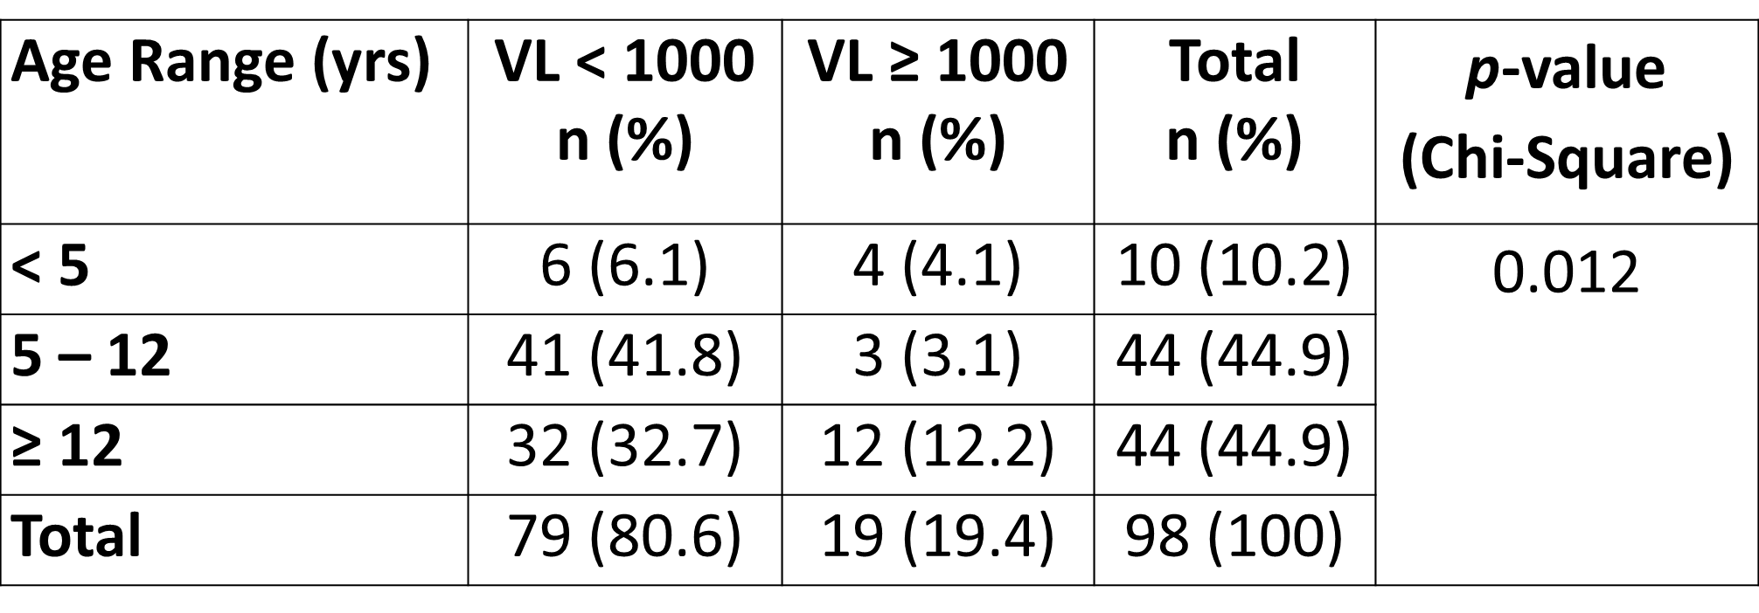
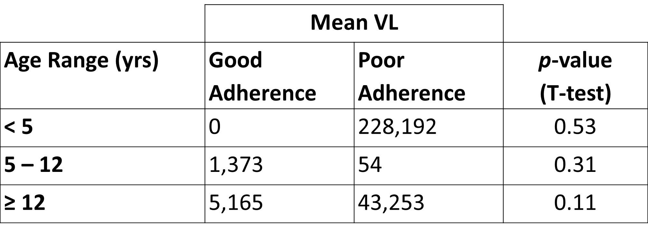
TANZANIA’S SECOND ACT: TO SUPPRESS OR NOT TO SUPPRESS? VIRAL LOAD SUPPRESSION AFTER SWITCHING TO SECOND-LINE ART AT BAYLOR CHILDREN’S CENTER OF EXCELLENCE IN MWANZA, TZ
Vicki Ip, MD^{1,2}, Kirk A. Scirto, MD^{1,2}, Mercy Minde, MD², Lumumba Mwita, MD²
¹Baylor International Pediatric AIDS Initiative (BIPAI) at Texas Children’s Hospital, Baylor College of Medicine - Houston, TX, USA;
²Baylor College of Medicine Children's Foundation - Mwanza, Tanzania
Affiliation and address
BACKGROUND
In 2015, the Government of Tanzania scaled-up viral load (VL) testing, thus, monitoring treatment failure in people living with HIV and switching to second-line antiretroviral therapy (ART) was simplified.
Currently, the WHO defines treatment failure as two consecutive VLs exceeding 1000 copies/ml after three months, with good adherence support, and after at least six months on ART.
This study reviews the relationship between adherence and VL when clients are started on second-line ART due to treatment failure at Baylor Center of Excellence (COE) in Mwanza, Tanzania.
METHODS
This is a retrospective chart review of 98 clients switched to second-line ART between March 2012 and December 2018 at the Mwanza COE.
Data collected from the electronic medical record included: age, sex, time between ART initiation to starting second-line, adherence pre- and post-second-line, reasons for therapy switching, second-line regimen, and follow-up VLs.
Poor adherence was defined as pill count </> 95-105% at any visit during the 6 months before or 6 months after switching to second-line.
Comparisons were made between children < 5 years old, 5 to 12 years old, and >12 years old.
RESULTS
The study included 98 clients (43 female).
Mean age at starting second-line was 10.6 years.
Average time to start second-line after ART initiation was 5 years.
The majority of clients were switched to second-line due to virological failure (46/98, 46.9%).
The most common second-line regimen was ABC-3TC-LPV/r (63/98, 64.3%).
Most clients had poor adherence 6 months before and after starting second-line (61/98, 62.2% and 55/98, 56.1%, respectively; χ²=0.76, p=.38).
After switching to second-line ART due to treatment failure, the majority of patients were able to achieve a VL < 1000 copies/mL, regardless of having good or poor adherence.
RESULTS CONT.
Most clients had VL <1000 copies/ml (79/98, 80.6%) after switching to second-line across all ages (Table 1), and 67.3% (66/98) had VL < 50. Chi-Square testing showed a statistically significant association (α=.05) between VL suppression and the three age categories (p=.012).
However, in all age groups, there was no significant difference in the mean VLs between those with good versus those with poor adherence (Table 2).
CONCLUSIONS
Most clients achieved VLs <1000 after switching to second-line ART due to treatment failure, regardless of having good or poor adherence.
While promising, adherence did not improve; the consequence of which is ART resistance and second-line failure.
Although VL testing has made monitoring treatment failure easier, Tanzania would benefit from nationwide resistance testing so only necessary regimen switches are made to preserve future ARV options.
Until then, our COE continues to rely on psychosocial counseling and support to address issues of adherence and treatment failure.
Table 1: Comparison of VLs after switching to second-line ART
Table 2: Comparison of mean VLs and adherence
PRESENTED AT THE 23RD INTERNATIONAL AIDS CONFERENCE (AIDS 2020) | 6-10 JULY 2020

