Slide 1
ADDRESSING CHALLENGES IN ACCESS TO HIV CARE
Janessa Broussard & Reina Hernandez

Slide 2
ACCESSING HIV CARE SERVICES IN THE BAY AREA
Challenges
Insurance:
Insurance access tied to employer
Limited number of HIV providers in-network
Safety:
Institutionalized bias toward LGBTQ communities, particularly POC-identifying
Clients frequently report previous trauma seeking care
Capacity:
Increasingly limited number of clinics and providers with HIV and LGBTQ care expertise
SFAF Approach
Community :
Sex positive
Harm reduction
Queer-centered
Teams that represent communities most at risk for HIV
Access:
Low-barrier and low-threshold
Walk-in services
Weekend and evening hours
Transportation assistance
Resource and benefits support

Slide 3
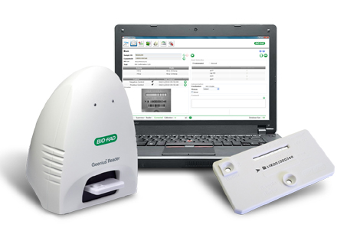
RAPID INITIATION OF ANTIRETROVIRAL THERAPY
Same day confirmation of HIV infection:
Geenius HIV 1/2 supplemental assay
July 2017 - December 2019, there were 113 positive 2nd generation tests
61 were found to be positive
100% concordance with gold standard lab-based confirmatory test
Confirmatory result time reduced from 3 day to 0 days
Demographics:
98 new HIV diagnoses
Median age was 31
50% Latinx, 11% Black
99% accepted Rapid initiation
Best Practices:
Same-day confirmation of infection
Onsite drop-in benefits and navigation
Establishing collaborative relationships with local providers
Non-clinical wraparound services

Slide 4
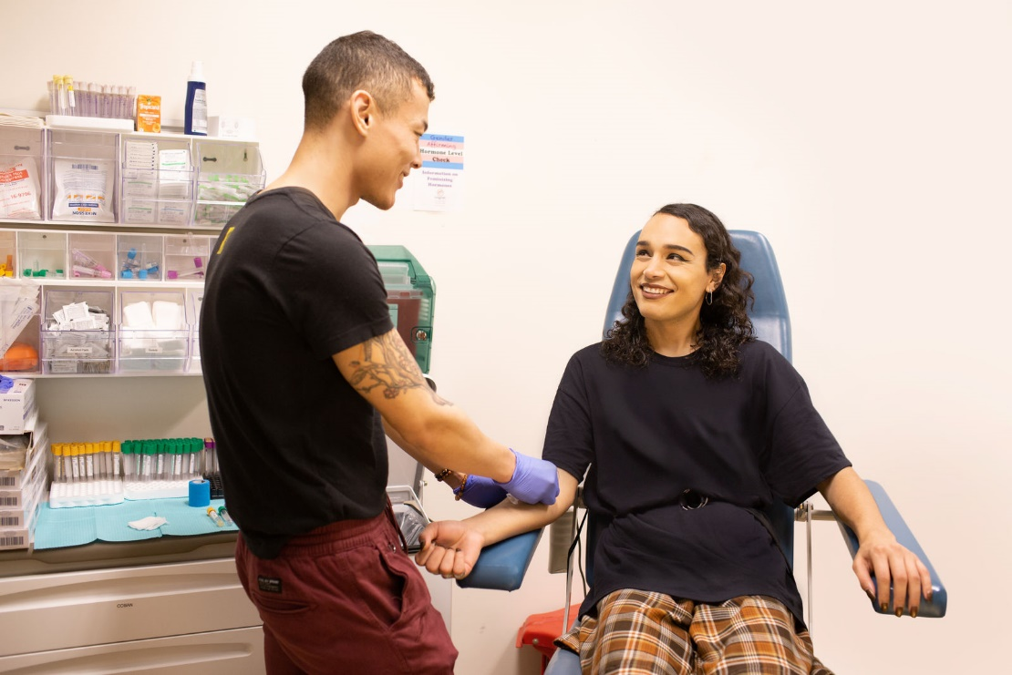
INTERIM ANTIRETROVIRAL THERAPY PROGRAM
Services:
Same-day drop-in appointments to bridge access to antiretrovirals
Access to no-cost labs, provider visit, medication acquisition and benefit navigation
Model:
Increased language capacity- staff development & translation technology
Highly specialized health & benefit navigation team
Drop-in services model
Weekend and evening hours
Community-based staffing and representation

Slide 5
INTERIM ANTIRETROVIRAL THERAPY PROGRAM
Demographics:
99 seeking access to HIV care
25% Latinx, 8% Black
55 uninsured (16 unknown insurance status)
48 currently on antiretroviral therapy
Client Experience:
“My experience at Strut/Magnet was great. I benefited in knowing I have a support and resources in my city that can help me stay healthy and content. I don’t know who I would’ve contacted had I not had the help from Strut/Magnet in getting my HIV meds. I’m sure I would still be making phone calls in order to get the help I received from them.”

Slide 6
Thank you!
Reina Hernandez
PrEP Benefits and HIV Linkage Manager
rhernandez@sfaf.org
Janessa Broussard MSN, RN, AGNP-C
Senior Director of Clinical Services
jbroussard@sfaf.org

