Slide 1
Understanding preferences for HIV care among patients experiencing homelessness in San Francisco
Madellena Conte
Notes:
Hello. My name is Madellena Conte and I will be presenting: Understanding preferences for HIV care among patients experiencing homelessness in San Francisco

Slide 2
No conflicts of interest to disclose
Notes:
I have no conflicts of interest to disclose.

Slide 3
Funding
Direct CFAR Funding Support
This research was supported by an Ending the HIV Epidemic Supplemental grant from the National Institutes of Health to the UCSF-Gladstone Center for AIDS Research (P30 AI027763).
Indirect/Partial Funding Support
This publication/presentation/grant proposal was made possible with help from an Ending the HIV Epidemic supplement to the UCSF-Gladstone Center for AIDS Research (CFAR), an NIH-funded program (P30 AI027763).
Notes:
This research was supported by an Ending the HIV Epidemic Supplemental grant from the National Institutes of Health to the UCSF-Gladstone Center for AIDS Research.

Slide 4
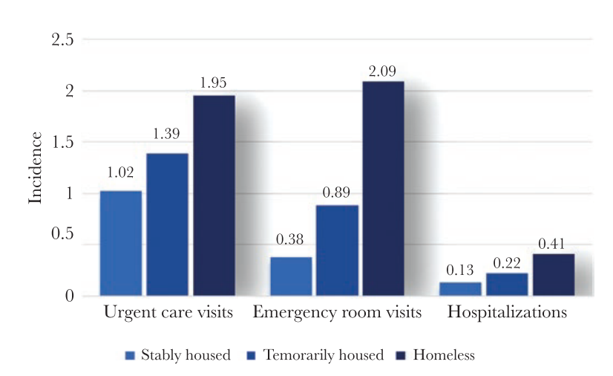
Housing instability results in increased acute care utilization
Source: Clemenzi-Allen et al. Open Forum Infect Dis, 2019
Notes:
Experiencing homelessness and unstable housing leads to suboptimal primary care visit adherence and high acute care utilization among people living with HIV across a continuum of housing instability, shifting care delivery towards settings that are poorly equipped to mitigate complex psychosocial and structural barriers to HIV care.
(NEXT)

Slide 5
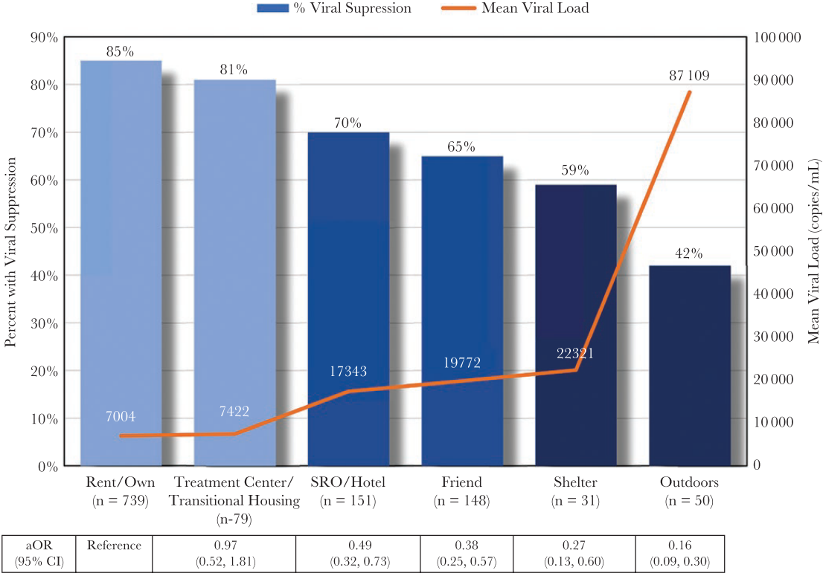
Housing instability results in increased acute care utilization
Homelessness is a barrier to realizing the full benefits of ART
Source: Clemenzi-Allen et al. Open Forum Infect Dis, 2019 (left); Clemenzi-Allen et al. Open Forum Infect Dis, 2018 (right)
Notes:
Consequently, virologic suppression decreases across a continuum of housing instability, leading to poor individual outcomes and increased HIV transmission.

Slide 6
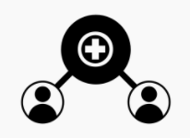
Strategies to improve outcomes for people living with HIV experiencing homelessness
Enhancing patient-centered care
Financial incentives
Low-barrier access to primary care visits
Direct Communication with Care Team
Source: Beach et al. J Gen Intern Med, 2006; Cunningham et al. JAMA Intern Med, 2018; Metsch et al. JAMA, 2016; Dombrowski et al. AIDS Patient Care STDS, 2018;
Notes:
Multiple strategies exist to improve retention in care and virologic suppression among people living with HIV experiencing homelessness and unstable housing, including (NEXT) enhancing patient-centered care, (NEXT) financial incentives, (NEXT) providing low-barrier access to primary care visits and (NEXT) allowing for direct communication with care team using mobile technology.
Owing to multi-level barriers to care, including individual-level characteristics (such as substance use disorder, psychiatric disease, and food insecurity) in addition to the structure of primary care delivery (scheduled clinic appointments and negative patient-provider relationships), improving care outcomes among this population may require multi-component interventions in addition to changing the structure of primary care delivery.
However, consensus on program design does not exist.

Slide 7
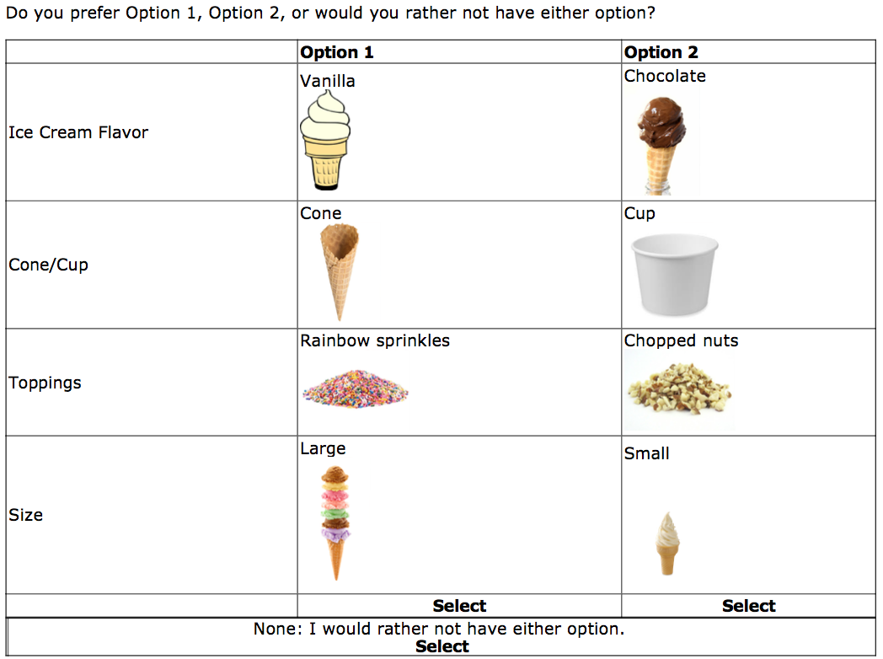
Discrete choice experiment to quantify patient preferences
Source: Zanolini et al. PLOS Med, 2018; Shumway et al. AIDS Care, 2019
Notes:
Patient preferences can be used to help prioritize program design and evaluate tradeoffs between clinic components across multiple service domains.
A discrete choice experiment is a research tool commonly used in marketing that quantifies patient preferences and evaluates trade-offs between components.
(NEXT)
I will use this ice cream example to clarify. On the left we see a menu with different ice cream components. (NEXT) We can use these options to construct a discrete choice experiment on the right that includes various descriptions of ice cream such as flavor, toppings, and size.
Say I am given the task to choose between ice cream option 1 or 2. At first, I may want to choose option 2 if chocolate is my favorite flavor. But, say I really dislike nuts – I may make the trade-off to ultimately choose ice cream option 1 so that I avoid the attribute I dislike. Using multiple “choice tasks”, patient preferences and tradeoffs can be evaluated.

Slide 8
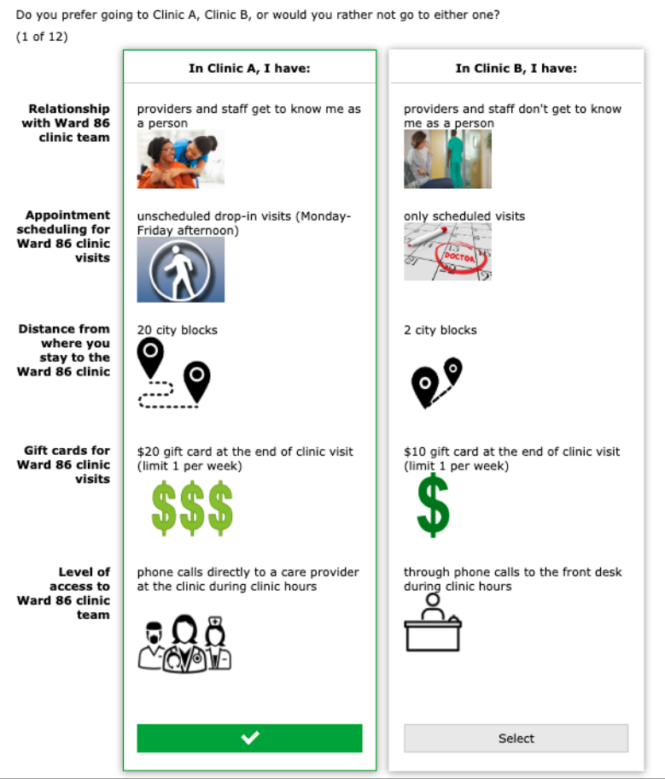
Selection of attributes in the discrete choice experiment
Source: Beach et al. J Gen Intern Med, 2006; Gardner et al. Clin Infect Dis, 2014; Yehia et al. BMC Infect Dis, 2015; Dombrowski et al. AIDS Patient Care STDS, 2015
Notes:
To incorporate patient preferences into solutions for more effective care for PLWH experiencing homelessness or unstable housing, we quantified patient preferences and financial trade-offs across multiple possible HIV service domains.
In the experiment, patients chose between 2 hypothetical clinics which varied by clinic components.
These components were based on a literature review of evidenced-based interventions that improved retention in care among PLWH experiencing homelessness.
We then conducted 10 semi-structured interviews to confirm acceptability of attributes.
The resulting attributes were the following:
- having patient-centered care, defined as “providers and staff get to know me as a person” vs not,”
“scheduled visits” or “unscheduled drop-in visits”
gift cards for attending clinic visits in the amount of $10, $15, or $20
direct phone communication to care team versus front-desk staff.
and the distance to the clinic (2 vs. 20 city blocks)

Slide 9
Methods Overview
3 eligibility criteria:
Homeless or unstably housed (HUH)
Virologic non-suppression
Poorly retained in HIV primary care
referrals & surveillance records
Mixed logit regression to estimate the relative utility (preference)
Source: Clemenzi-Allen et al. Open Forum Infect Dis, 2018; Bridges et al. Value Health, 2011; Johnson et al. Value Health, 2013
Notes:
The study was conducted at San Francisco General Hospital’s “Ward 86” HIV clinic between March and July of 2019, which has a 37% prevalence of patients experiencing homelessness or unstable housing.
We sequentially sampled Ward 86 patients reporting HUH who had at least 1 missed primary care visit in the last year and recent viremia to conduct the choice experiment. Patients were recruited through clinic provider referrals.
In the analysis, we estimated relative utility (i.e., preference) for attribute levels using mixed-effects logistic regression and calculated the monetary trade-off of preferred options by performing a willingness to pay analysis.

Slide 10
Participant demographic and clinical information
242 patients referred
Patient Characteristics: N=65
61% >40 years-old
77% male
55% non-white
25% heterosexual
56% lived outdoors or in emergency housing
44% in temporary housing
192 did not meet enrollment criteria
65 completed DCEs with eligible patients
Notes:
A total of 242 patients were referred for survey participation, of whom 192 did not meet enrollment criteria, yielding 65 eligible patients who completed the choice experiment.
Of the individuals enrolled, 61% were >40 years-old; 77% male; 55% non-white; 25% identified as heterosexual; 56% lived outdoors or in emergency housing, and 44% lived in temporary housing.
__________________

Slide 11
Relative Utilities of Clinic Attributes
Notes:
The strongest preferences were for having patient-centered providers and drop-in clinic appointments. In our willingness to pay analysis, we found that patients were willing to trade $32.79 per visit to have patient-centered providers, and $11.45 per visit for drop-in visits.

Slide 12
Key Findings and Limitations
Key Findings:
People living with HIV (PLWH) who experience homelessness were willing to trade the possibility for financial gain to go to a clinic with:
1. providers who know them as a person ($32.79)
2. drop-in appointments ($11.45)
Limitations:
Stated preferences, not actual behavior
Implicit bias based on pictorial examples
Sampling likely focused on patients who are somewhat engaged with clinic staff
Limited perspectives from cisgender women
Notes:
The key finding was that PLWH who experience homelessness, who live on the economic margins and who often lack basic subsistence, were nevertheless willing to trade significant financial gain in a discrete choice experiment to have a personal relationship with and immediate access to the primary care team.
Limitations of this study include that DCEs measure stated preferences, and not actual behavior. Second, implicit bias based on the pictorial examples could have influenced patient’s decisions. Third, sampling likely focused on patients who are already somewhat engaged with clinic staff. Lastly, because our sample included few cisgender women, the study did not gain insight into unique preferences among this group who face other significant obstacles to engagement in care.

Slide 13
Implications
This is the first study to characterize preferences of people living with HIV experiencing HUH
PLWH experiencing HUH strongly preferred having providers that know them as a person
Further research is needed to understand how patients define patient-centeredness
Source: Shumway et al. AIDS Care, 2019; Johnson et al. AIDS Patient Care STDs, 2006; Wood et al. Patient Prefer Adherence, 2018; Zanolini et al. PLOS Med, 2018
Notes:
This is the first study to characterize the preferences of people living with HIV experiencing homelessness or unstable housing.
We found that PLWH experiencing homelessness strongly preferred having providers that know them as a person. Further research is needed to understand how patients define patient centeredness.
One of the take home messages is that, for PLWH experiencing homelessness or unstable housing, considerations of flexible clinic design and positive experiences with providers supersedes other considerations of clinical location.
These findings are supported by other literature, and can inform “Ending the HIV Epidemic” by guiding innovative programming to improve retention in HIV care for vulnerable populations.

Slide 14
Acknowledgements
Enormous thank you to:
Asa Clemenzi-Allen, MD, MAS
Diane Havlir, MD
Monica Gandhi, MD, MPH
Ingrid Eschun-Wilson, MD, MSc
Elvin Geng, MD, MPH
Elizabeth Imbert, MD, MPH
Matthew D. Hickey, MD
Nicole Santos, PhD, MS
Alden Blair, PhD, MS
Madhavi Dandu, MD, MPH
Clinic staff and patients at Ward 86
Photo source: https://medium.com/berkeleybie/sfgh-ward-86-hiv-clinic-49f951604f87
Notes:
I want to say an enormous thank you to all the mentors on this slide who made this research possible, including the clinic staff and patients at the Ward 86 HIV clinic at ZSFGH. Thank you.

Slide 15
For questions, you can contact me at:
Email: madellena.conte@gmail.com
Twitter: @MadellenaC
Notes:
For any questions, you can contact me through the email or twitter handle below.

